Slide 1
HIV Recency Testing in Rwanda
Placidie Mugwaneza, MD, MPH
Rwanda Biomedical centre

Slide 2
Background
Rwanda is committed to achieving the global target of ending the AIDS epidemic by 2030
Initiation of HIV recency testing was done as innovative approaches to efficiently monitor the HIV epidemic
Initiated in October 2018 in 23 health facilities in the Kigali
Plan to scale up nationwide to all viral load hubs

Slide 3
Background
Approaches used in implementing HIV recency testing:
Initially centralized testing at National lab
Central testing using 8 viral load hubs distributed across the country
Point-of-care testing (POCT) for recency in pioneer sites (23 health facilities)
Target: All sites with POCT for recency

Slide 4
Recency Testing Status by Month and Scale Up October 2018- May 2019

Slide 5
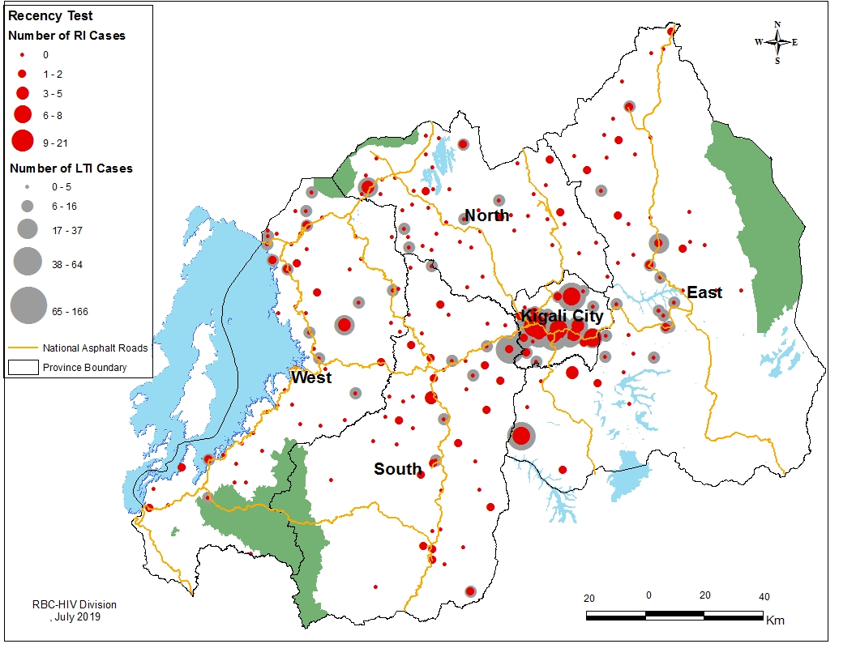
Distribution of Recent and Long-Term Infection across Rwanda

Slide 6
Recency Testing Status by Age Groups October 2018-May 2019

Slide 7
Proportion Recent Infection among Newly Diagnosed by Age group, October 2018-May 2019

Slide 8
Proportion Recent Among Newly Diagnosed by Age Bands and Sex*, October 2018-May 2019
14
12
10
8
6
4
2
0
Overall
Percent (%) Recent
15-24
(N=340)
25-34
(N=723)
35-44
(N=442)
45+
(N=269)

Slide 9
Distribution of Sex Among Newly Diagnosed PLHIV by Recency Status, October 2018-May 2019

Slide 10
Distribution of Age Among Newly Diagnosed PLHIV by Recency Status, October 2018- May 2019

Slide 11
Distribution of Recent Cases by Age and Gender, October 2018-May 2019

Slide 12
Proportion Recent Infections by Province October 2018-May 2019
12.5
9.4
9.1
Percent (%) Recent
4.9
4.6
4.0
Eastern
(N=215)
Kigali
(N=931)
Northern
(N=126)
Southern
(N=175)
Western
(N=238)
Rwanda
(N=1685)
*9 cases did not have sex documented

Slide 13
Median Turnaround Time for Recency Testing Results

Slide 14
Lessons Learned
Integration of HIV recency testing in routine HIV testing services is feasible
Acceptability increases with program scale up
Majority of people newly diagnosed have long term HIV infection
Strengthen active case finding strategies to identify people in the early stage of infection
Mobilize high risk populations to test for HIV as early as possible

Slide 15
Conclusions
Recent infections disproportionately occur in:
Young people: 15-24; 25-34 years
Females 15-24 where risk of new infection is >3 times higher compared to males
Planning of HIV prevention interventions needs to target specific populations
Adolescent and young adults

Slide 16
Thank you!

